Slide 1
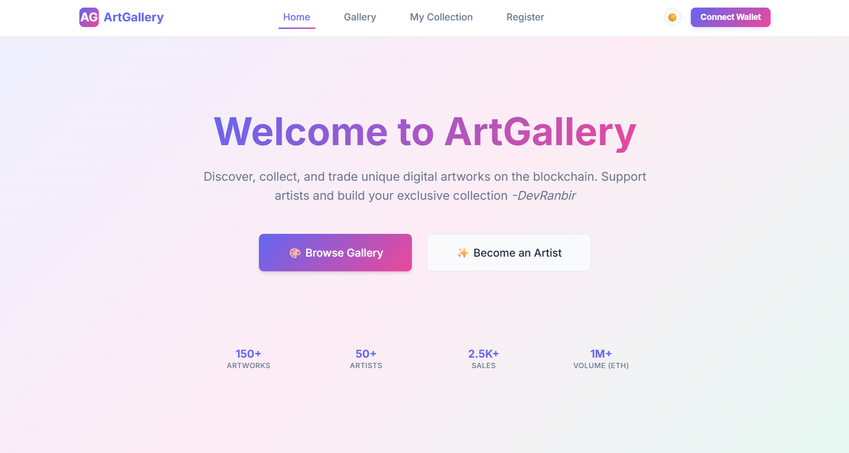
ArtGallery
A Decentralized Platform for Discovering and Collecting Digital Art.
Subtitle: A Decentralized Platform for Discovering and Collecting Digital Art, live at https://devranbir.github.io/artgallery/home
Core Technologies: React, Solidity, ethers.js
Developer: Ranbir Khurana, 24BCS11076

Slide 2



# Project Vision & Overview
Vision
To create a secure, transparent, and artist-friendly marketplace for digital artworks.
Core Functionality
A React-based web app that allows users to connect a crypto wallet, browse a gallery of art, purchase pieces, and manage their personal collection.
Target Audience
Digital artists, art collectors, and cryptocurrency enthusiasts.

Slide 3
# Technology Stack - Frontend
Framework: React.js (src/index.js).
# Technology Stack - Backend (Smart Contract)
Blockchain Interaction: ethers.js library to communicate with the Ethereum smart contract (src/App.js).
Language: Solidity (contracts/ArtGallery.sol).
Routing: React Router for navigating between different pages like Home, Gallery, and Collection (src/App.js).
Contract ABI: The Application Binary Interface (ABI) is defined directly in App.js for frontend interaction.
API Calls: Native fetch API is used for external data, like getting the ETH-to-INR exchange rate from CoinGecko (src/components/Tip.js).
Key Functions:
registerArtist(string name)
uploadArtwork(string title, ..., uint price)
Deployment: Configured for deployment on GitHub Pages.
purchaseArtwork(uint _artworkId)
tipArtist(address artist)
Various get functions to retrieve artwork and artist data.
GitHub Repo: https://github.com/DevRanbir/artgallery

Slide 4
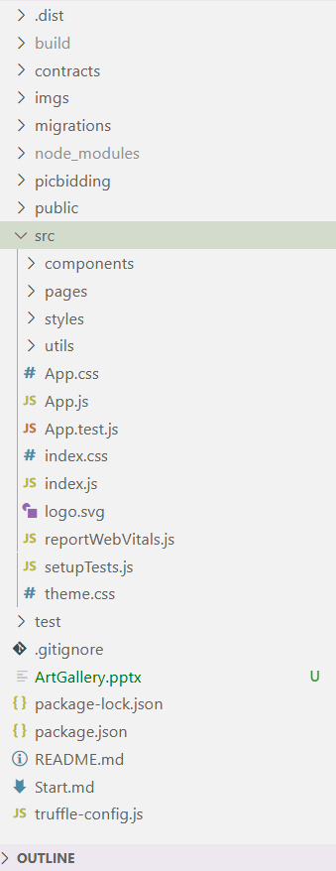



# Project Structure
src
The main application source code.
components/: Reusable UI elements like ArtworkCard.js, ArtworkViewer.js, and Tip.js.
pages/: Top-level components for each route, such as HomePage.js and RegisterPage.js.
styles/: A collection of CSS files for modular styling (e.g., gallery.css, collection.css).
contracts
Contains the Solidity smart contract.
public
Static assets, including index.html and the web app manifest.
GitHub Repo: https://github.com/DevRanbir/artgallery

Slide 5
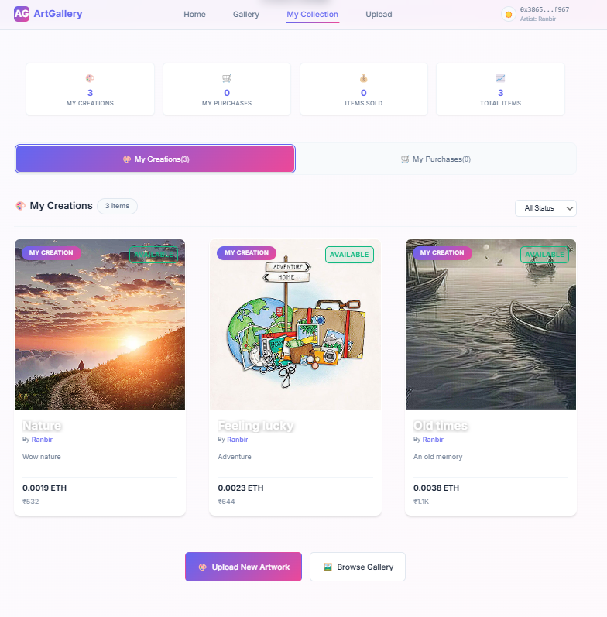
# The Pages
Dashboard View: Acts as a personal dashboard for users.
Key Stats: Displays key metrics at a glance: number of creations, purchases, items sold, and total items (src/pages/MyCollectionPage.js).
Tabbed Interface: Uses tabs to cleanly separate "My Creations" from "My Purchases," showing counts for each category.
Status Badges: Artworks in the collection are clearly marked with their status (e.g., "For Sale," "Sold," "Removed") for easy management (src/styles/artwork-card.css).
GitHub Repo: https://devranbir.github.io/artgallery/collection

Slide 6
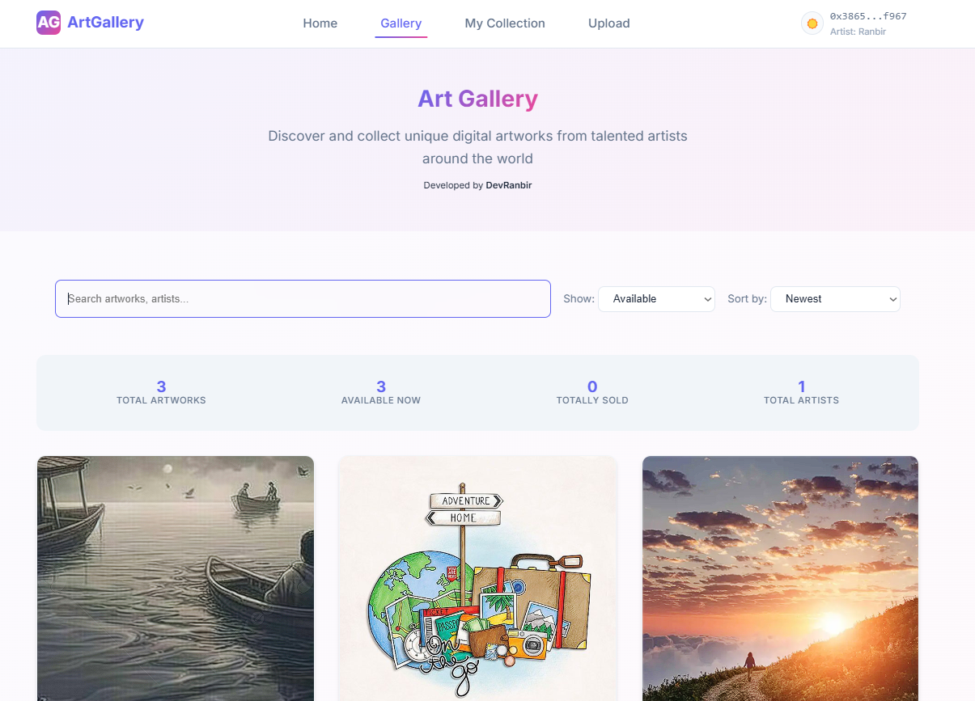

# UI & Styling – A Modern Approach
Visual Flair
Liberal use of linear-gradient for backgrounds, buttons, and even text to create a vibrant, modern aesthetic (src/styles/gallery.css).

Slide 7
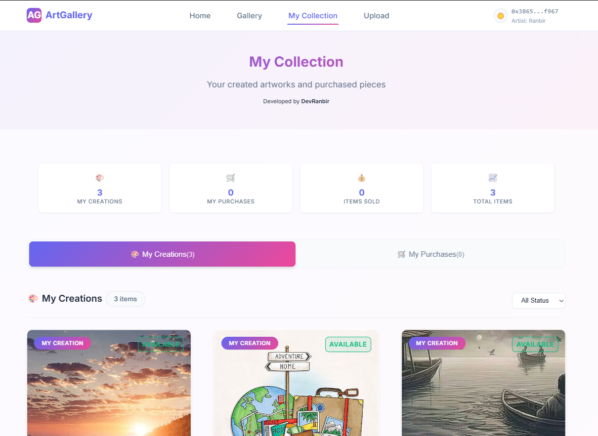

# UI & Styling – A Modern Approach
Modular CSS
Styles are broken down by component or page, promoting organization and avoiding conflicts.

Slide 8
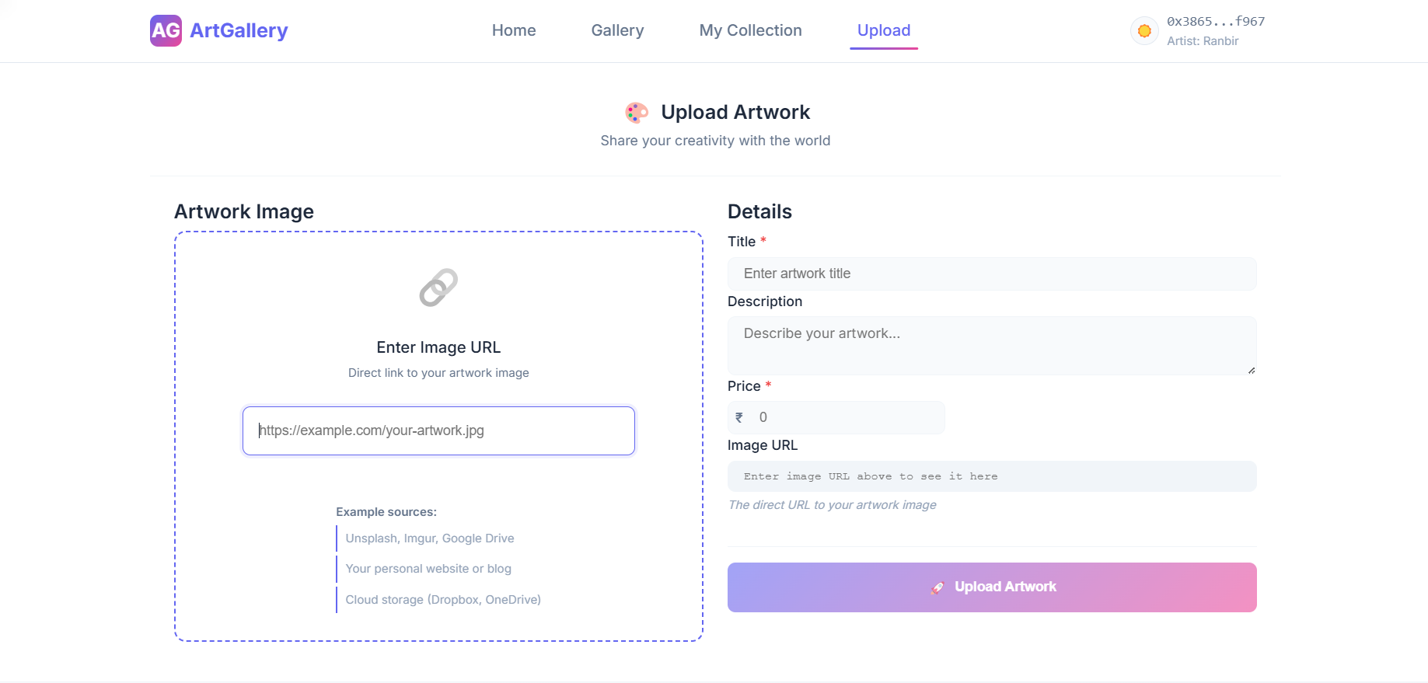
# UI & Styling -Upload Page

Slide 9
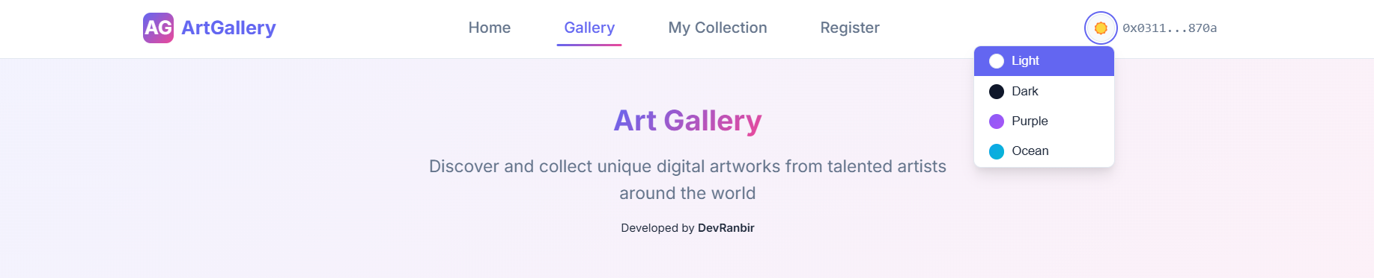
# UI & Styling -Navbar & Header
Navigation Buttons
User’s Name & Id
Page Title & Description
Theme Selector
Developer’s Name

Slide 10
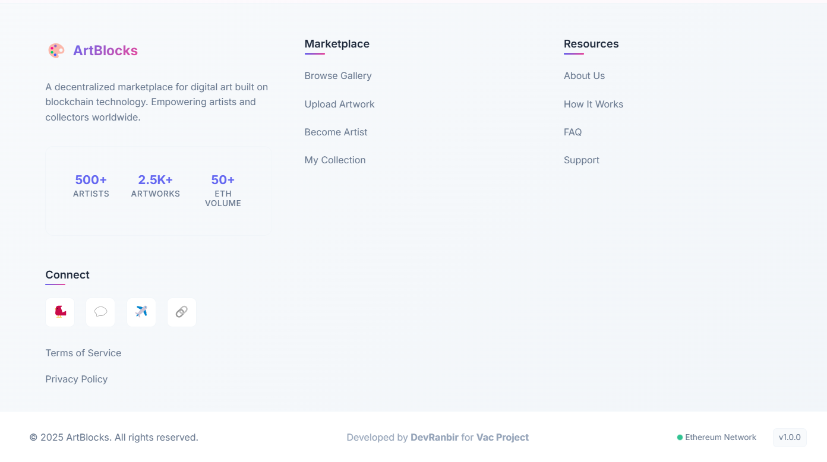
# UI & Styling -Fotter
Fast Access Links
About
Socials
Terms & Copyright
Watermark
Server Properties

Slide 11
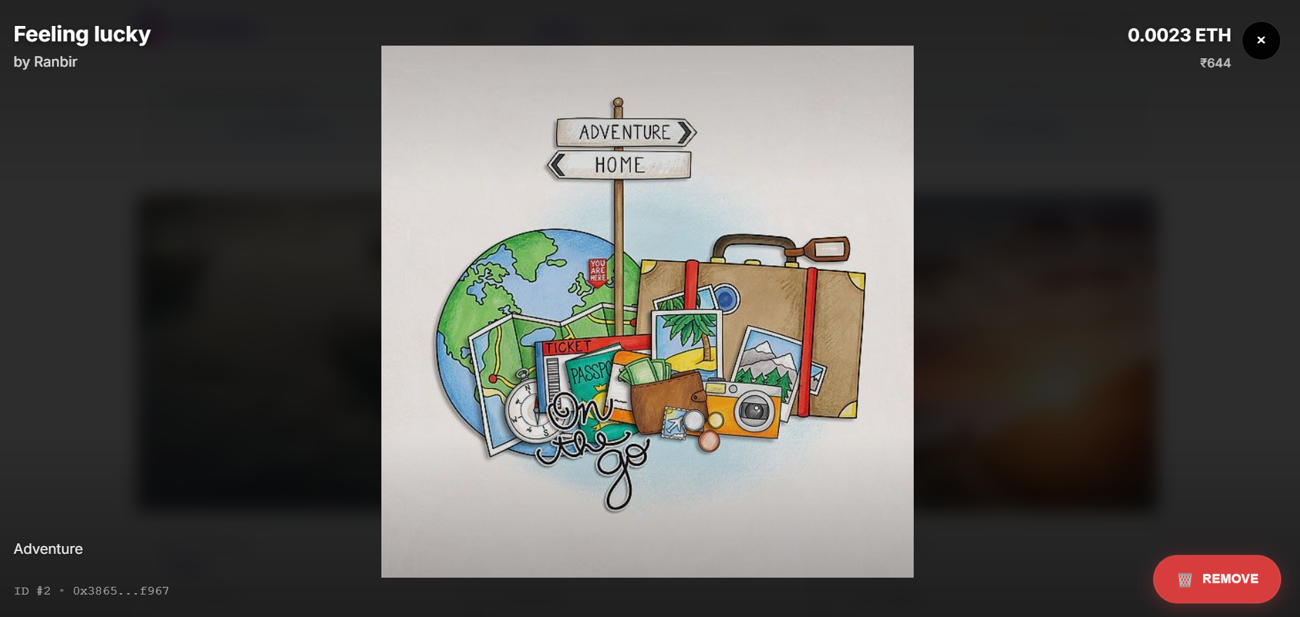
# UI & Styling -Other pages: Preview/View page

Slide 12
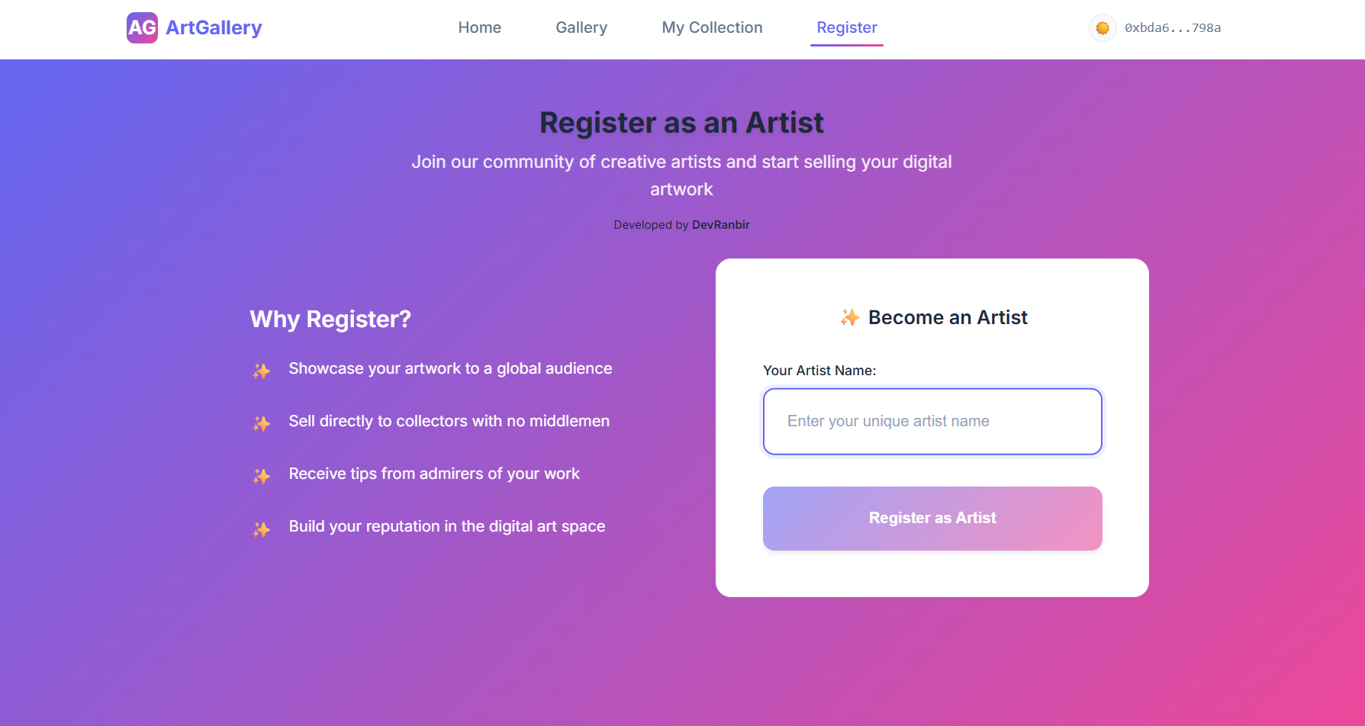
# UI & Styling -Register Page

Slide 13
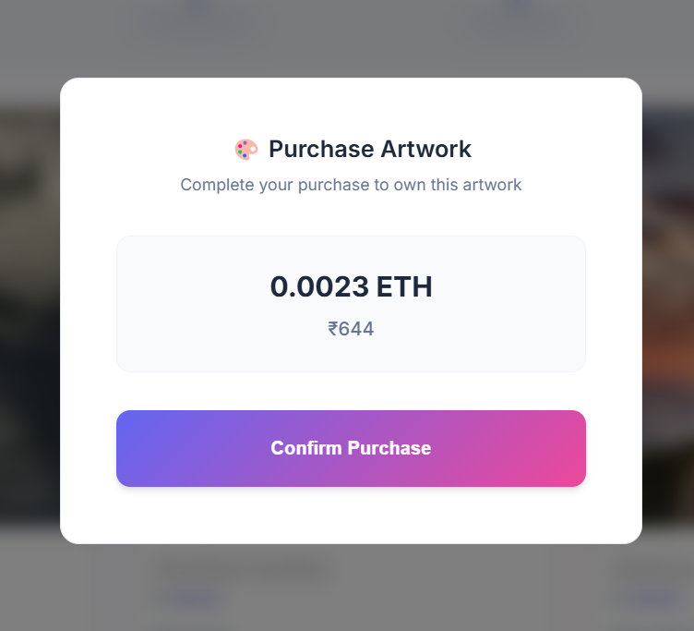
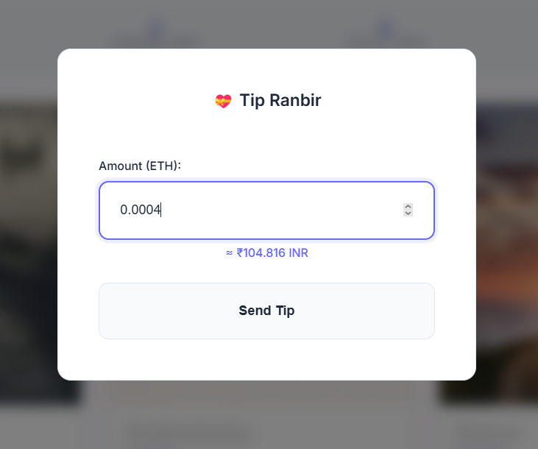
# The Tipping/Buying Artwork
Artist Support
A small but significant feature that fosters a direct connection between collectors and artists.
Dynamic Conversion
Fetches the live ETH to INR exchange rate and displays the approximate value as the user types their tip amount.
Modal Implementation
Appears as a modal overlay, preventing disruption to the main page flow (src/styles/main.css).
Self-Contained Logic
The component encapsulates all its logic, from API calls to transaction handling (src/components/Tip.js).

Slide 14
# Key Features
Wallet Integration
Artist Registration
Seamless connection with MetaMask to handle transactions and user authentication.
A dedicated flow for artists to register and get verified on the platform.
Artwork Minting
Gallery & Discovery
Registered artists can upload their work, add details, set a price, and mint it on the blockchain.
A central gallery to explore all available artworks with search and filter capabilities.
Personal Collection
Direct Tipping
A user-specific page displaying both created artworks ("My Creations") and purchased pieces ("My Purchases").
A feature allowing users to send tips directly to artists in ETH.

Slide 15



# Summary
ArtGallery is a decentralized digital art marketplace leveraging Ethereum blockchain technology to empower artists and collectors. Artists can register, mint their artworks as NFTs, and list them for sale directly on the platform using Solidity smart contracts. Collectors connect their crypto wallets (like MetaMask) to securely purchase, own, and tip artists, with all transactions transparently recorded on-chain. The use of blockchain ensures authenticity, ownership, and trustless peer-to-peer interactions, making the art trading process secure, transparent, and censorship-resistant.
# Hosted on:
# Contract deployed on:
# Powered by:

Slide 16

# Links
Live website: https://devranbir.github.io/artgallery/home
GitHub Repo: https://github.com/DevRanbir/artgallery
More Projects: https://github.com/DevRanbir
For detailed instructions on the deployment process, please refer to the README.md file available on GitHub.
Direct link: https://github.com/DevRanbir/artgallery/blob/master/README.md

Slide 17

Thank You, That it…..
Do you have a Question? Mail at: Ranbirkhurana195@gmail.com

